Slide 1

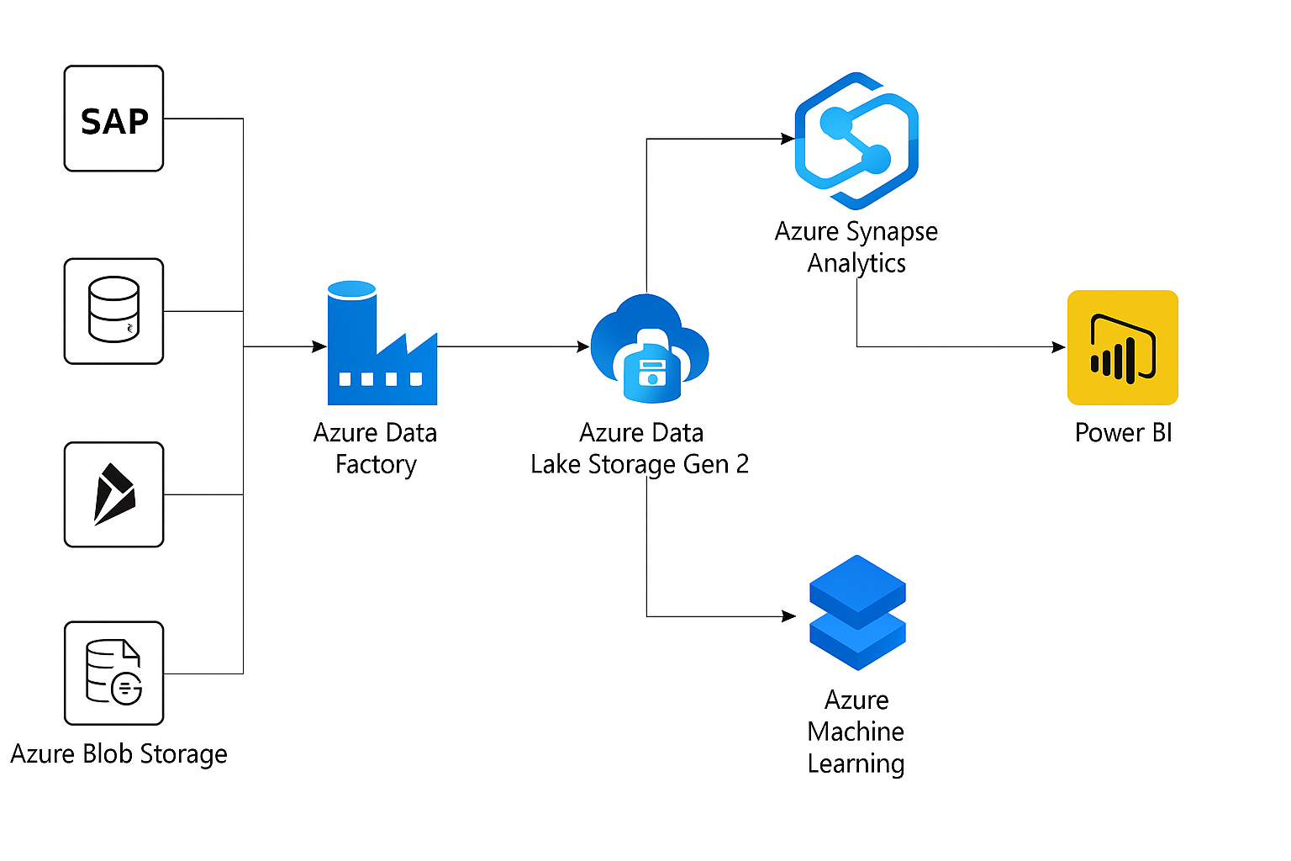
Cloud Architecture Flowchart
Presented by Ama Ananaba

Slide 2
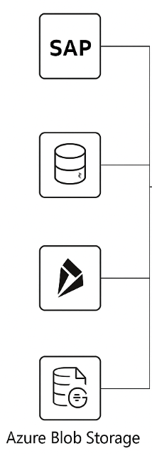
Data Sources
From top to bottom: SAP, Oracle DB, Dynamics 365, and Azure Blob Storage.
These are STK’s existing platforms where key operational, customer, and product data live.
They are where data are extracted for centralized analysis.

Slide 3

Data Ingestion & ETL
ETL stands for Extract, Transform & Load
Azure Data Factory acts like a “data robot courier” that travels to each source and fetches the data.
It supports automated & scheduled pipelines.

Slide 4

Azure Data Lake Storage
STK needs a single storage layer for raw files, processed structured data & future scalability and Azure DLS serves as a centralized cloud data storage.
It handles both structured and unstructured data & integrates well with Synapse, Databricks and ML.

Slide 5

Azure Machine Learning (ML)
Azure ML enables data scientists to build, train, and deploy models using existing data in the lake.
It helps predict delays, optimize routes, forecast demand, and train models on historic data.

Slide 6
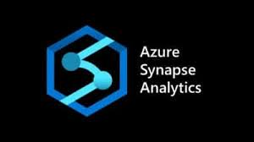
Azure Synapse Analytics
This is Azure’s query engine and data analytics platform.
It can help STK run complex SQL queries, transform data into usable formats, and power dashboards using Power BI.
It supports big data workloads and connects directly with Data Lake.

Slide 7

Power BI
This is a data visualization and reporting tool.
It integrates seamlessly with Synapse & ML.
It enables STK track KPIs, monitor AI/ML model outputs, and view dashboards.

